Slide 1


Slide 2
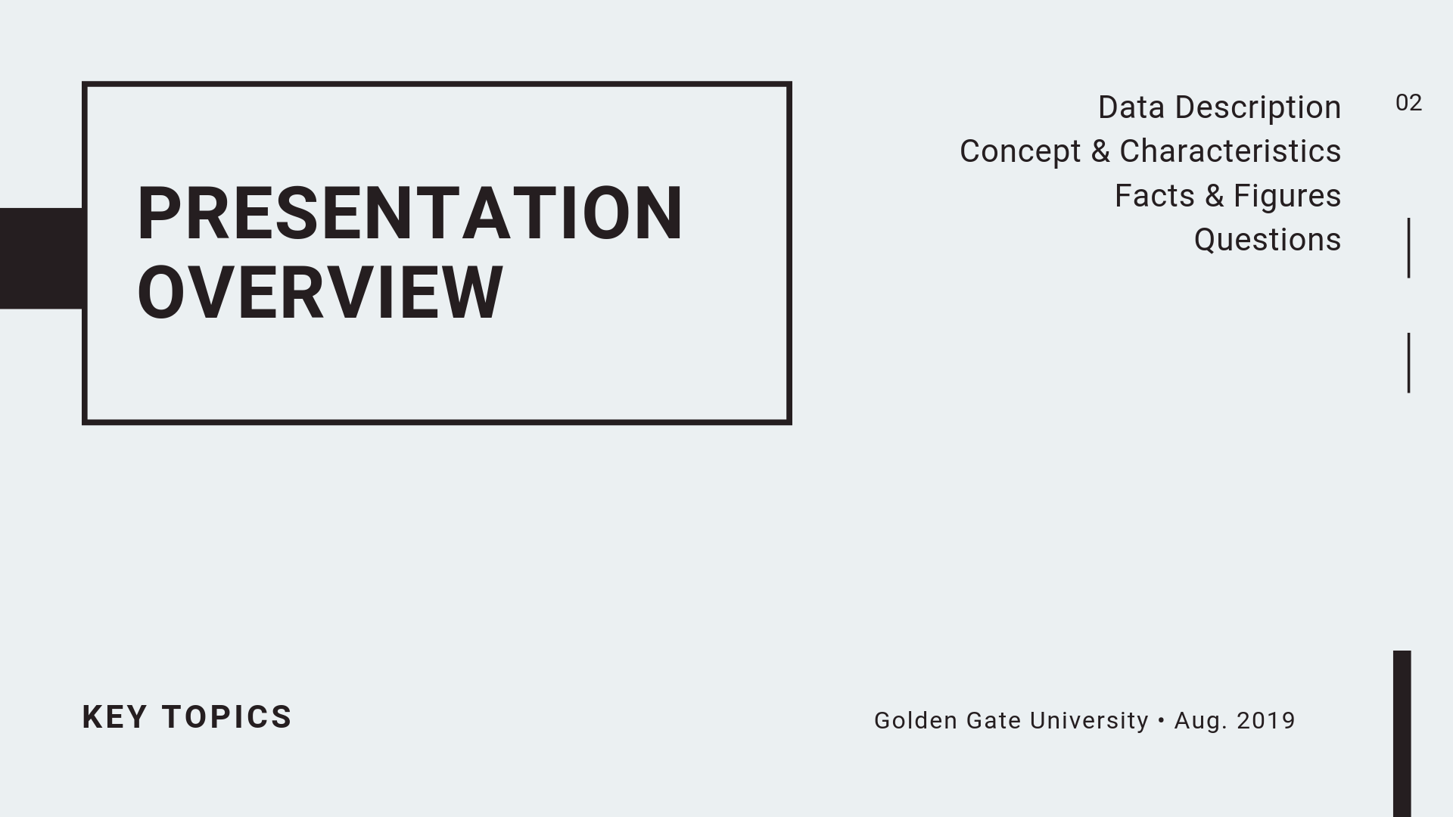

Slide 3
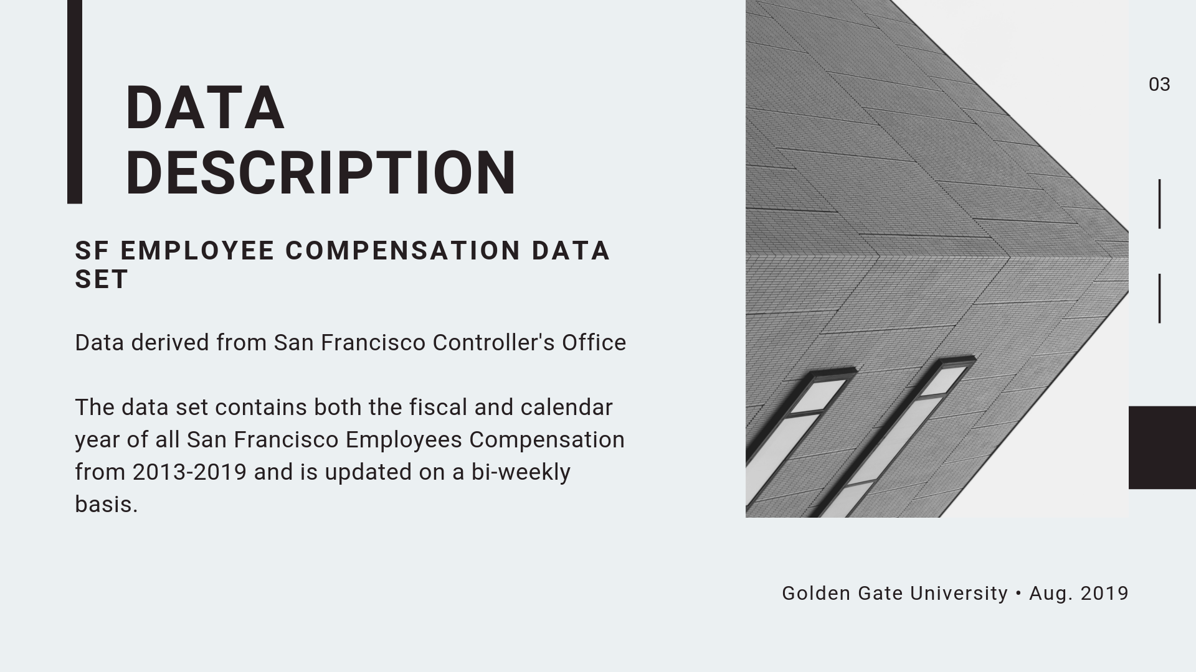

Slide 4
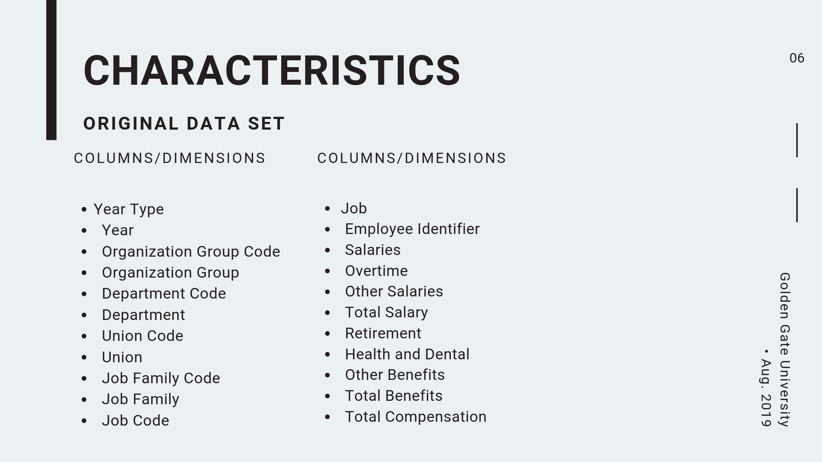

Slide 5
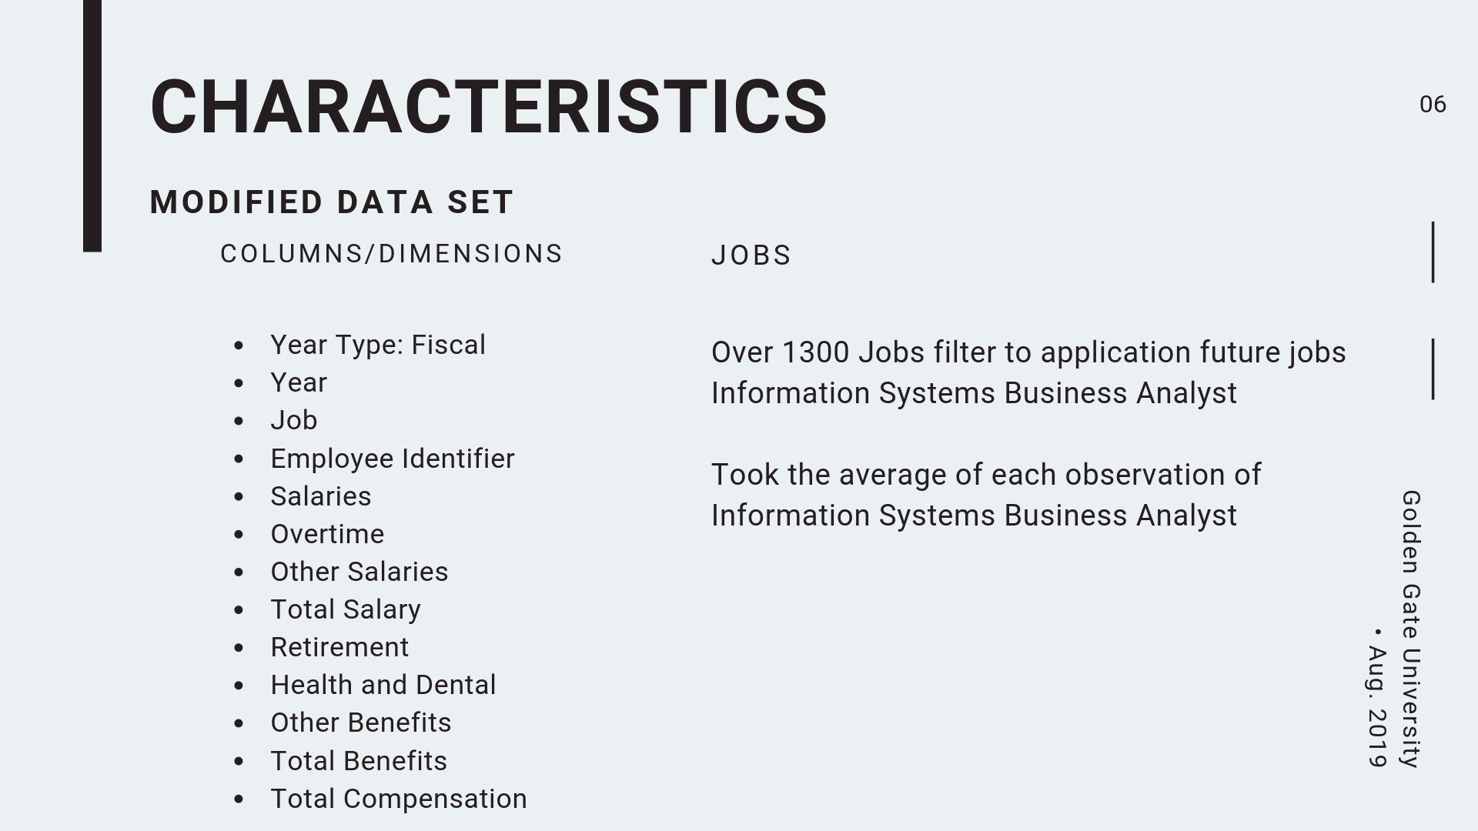

Slide 6
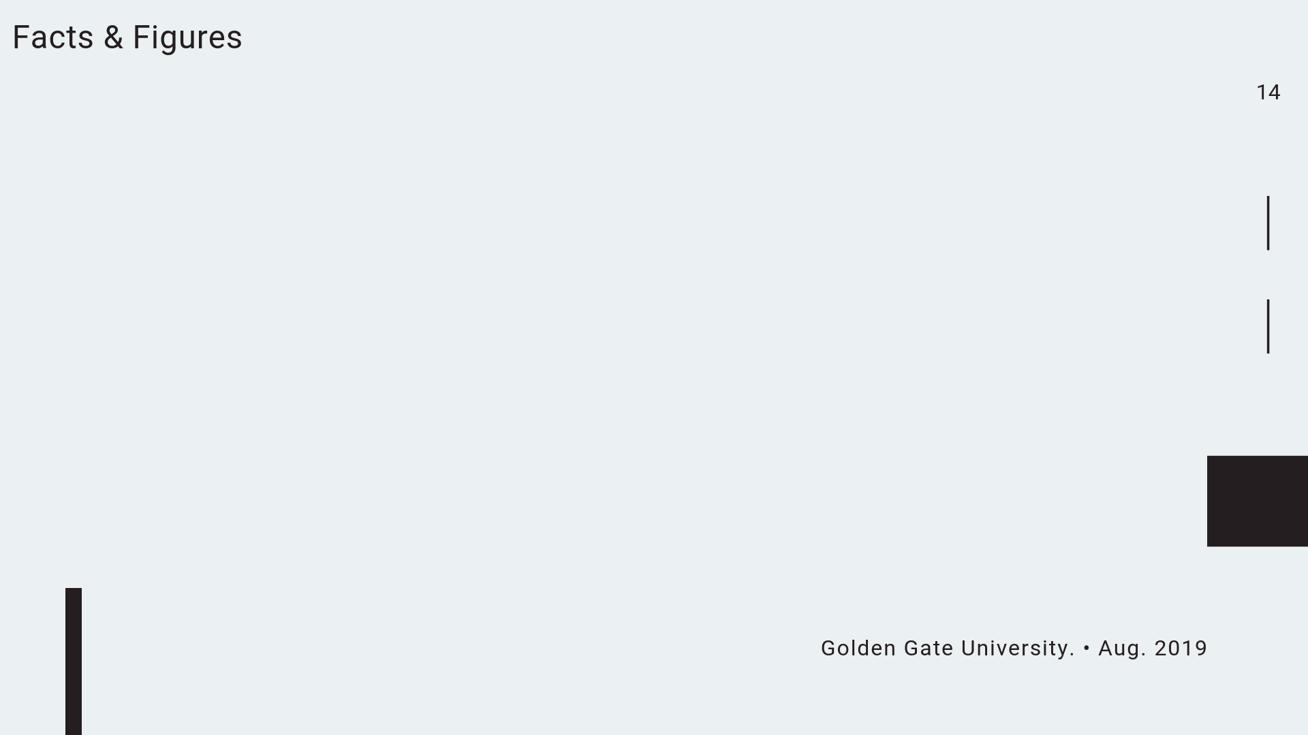
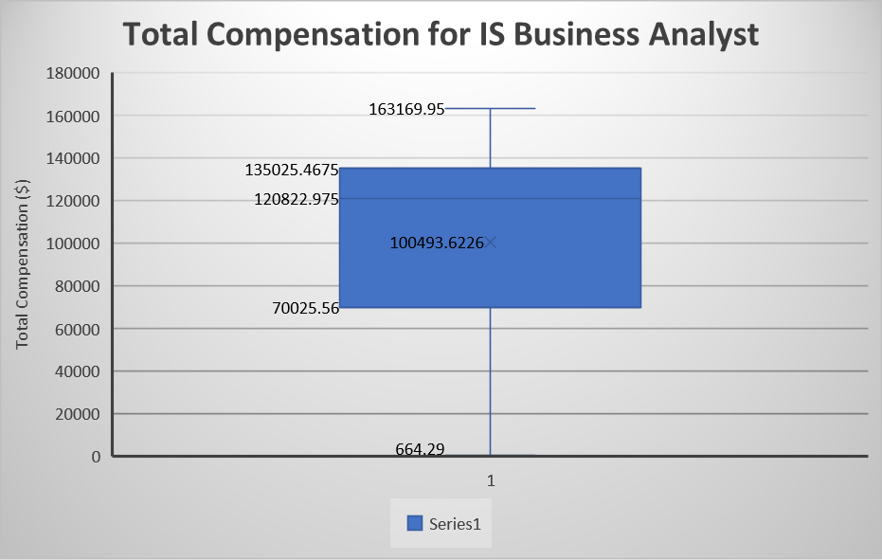
Box and Whisker plot
5 summary rules
Q0(min) | 664.29
Q1 | 70025.56
Q2(median) | 120822.975
Q3 | 135022.8025
Q4(max) | 163169.95
1.5 IQR calculation
IQR | Q3-Q1 | 64997.24
Lower fence | Q1 - 1.5IQR | -27470.3
Upper fence | Q3 + 1.5IQR | 232518.7

Slide 7
Probability for yearly total compensation
Total Compensation Amount | # IS Business Analysts
Under $50000 | 161
$50000-$79999 | 51
$80000-$99999 | 26
More than $100000 | 370
Grand Total | 608
P1=P (IS Business Analyst Compensation >= $80,000) = (26 + 237) / 474
P1=65.13%
P (IS Business Analyst Compensation < $50,000) = (160) / 474
P2=26.48%

Slide 8
Highest compensation as per department

Slide 9

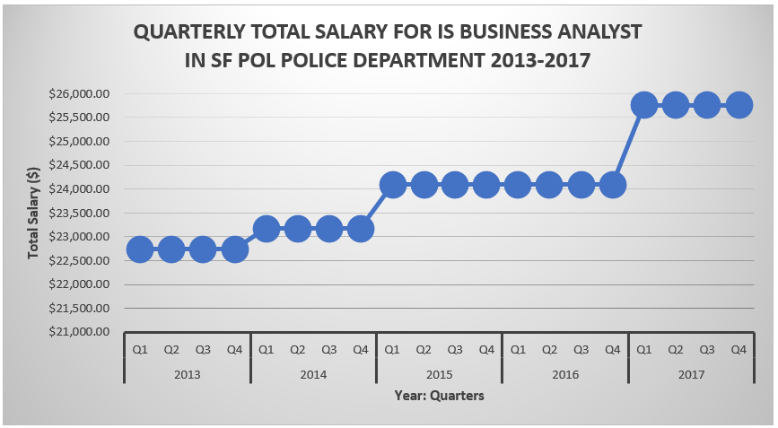
Dimensional Comparison

Slide 10
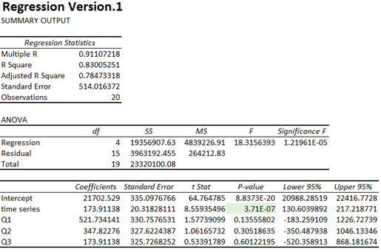
Dimensional Comparison

Slide 11
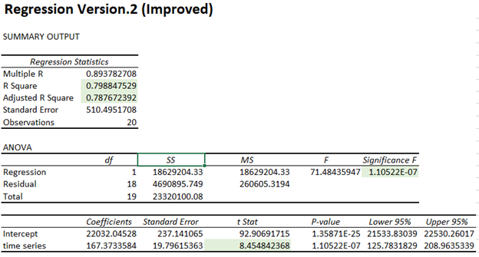
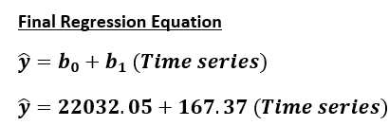
Dimensional Comparison

Slide 12
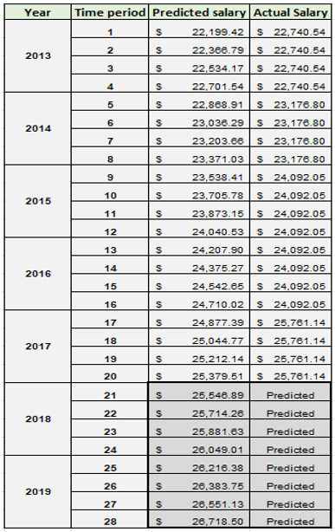
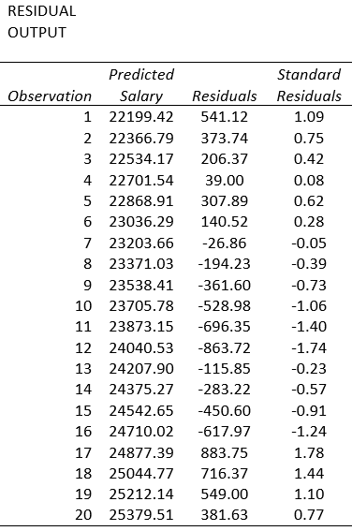

Slide 13
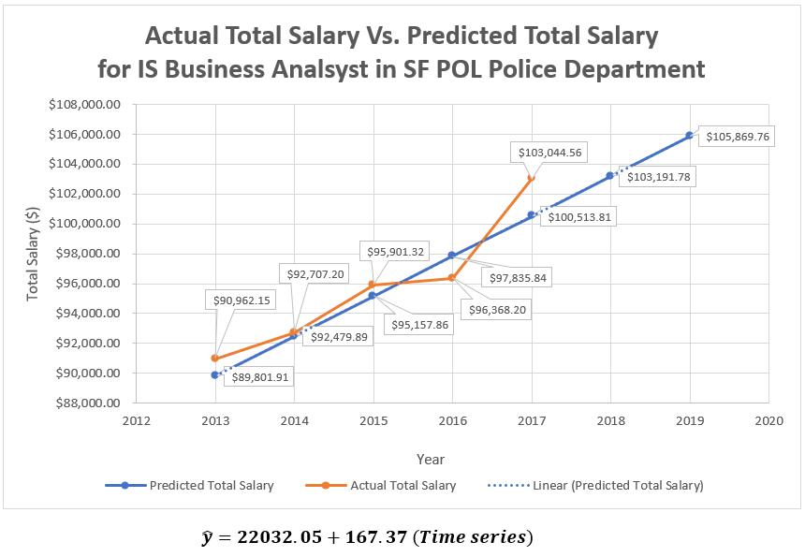

Slide 14
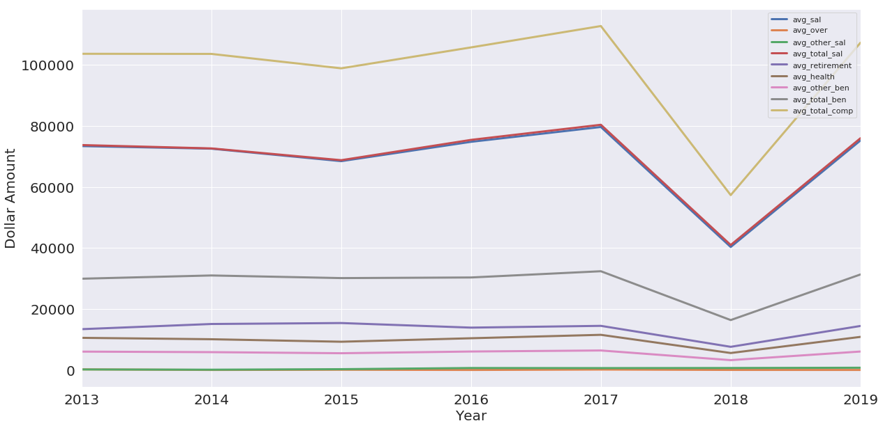
Dimensional Comparison

Slide 15

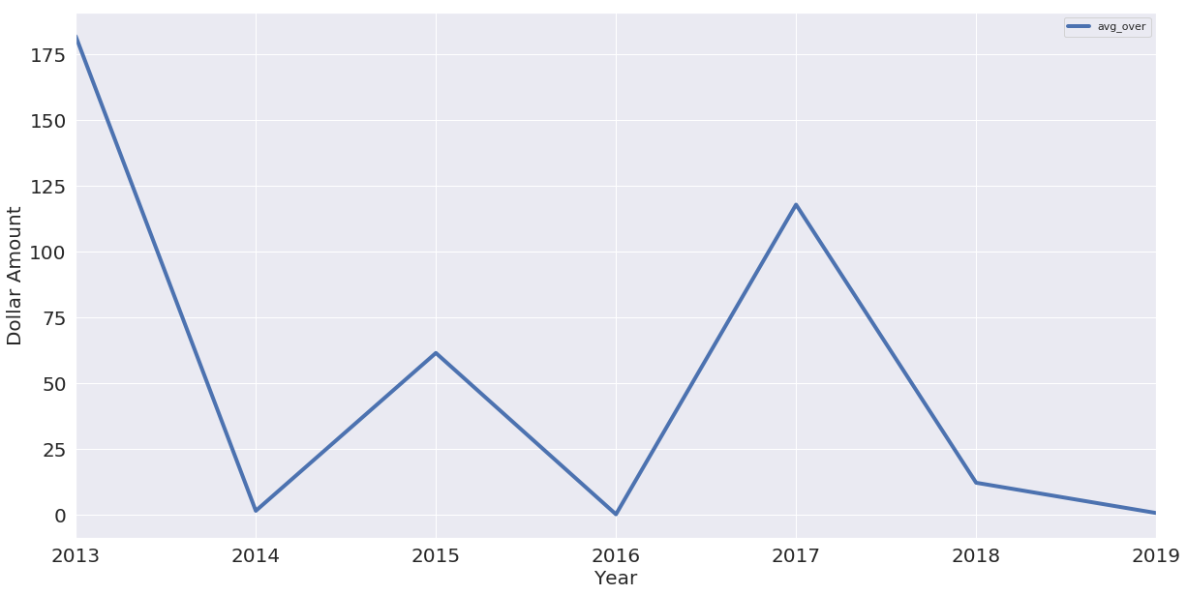
Average Overtime

Slide 16

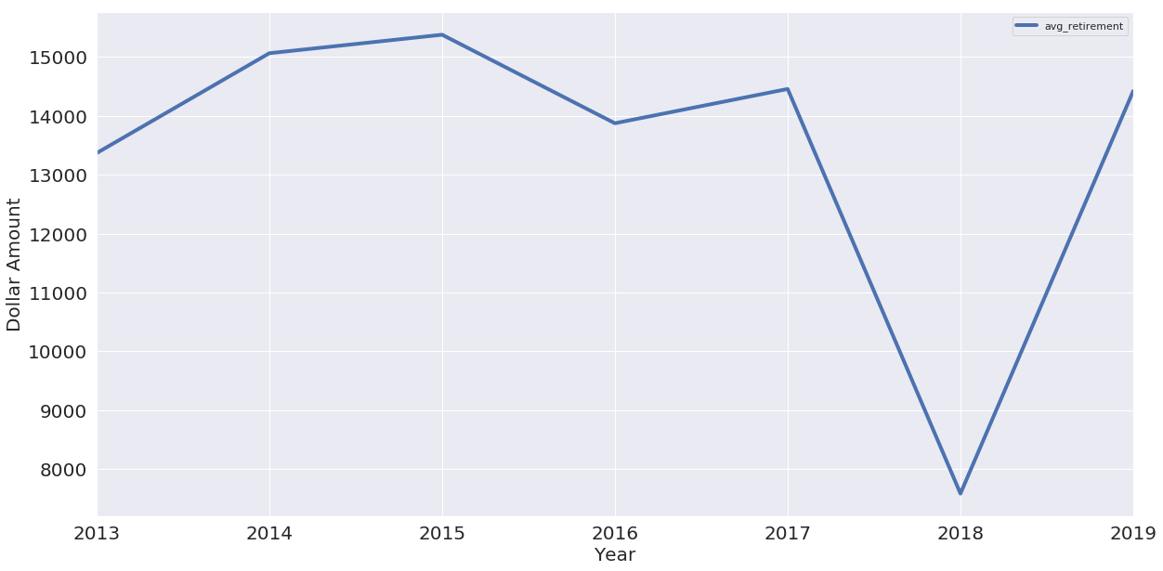
Average Retirement

Slide 17

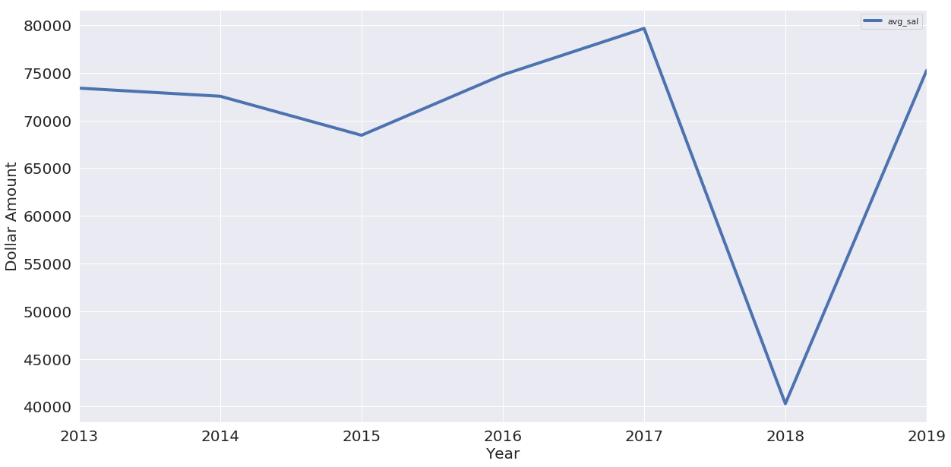
Average Salary

Slide 18

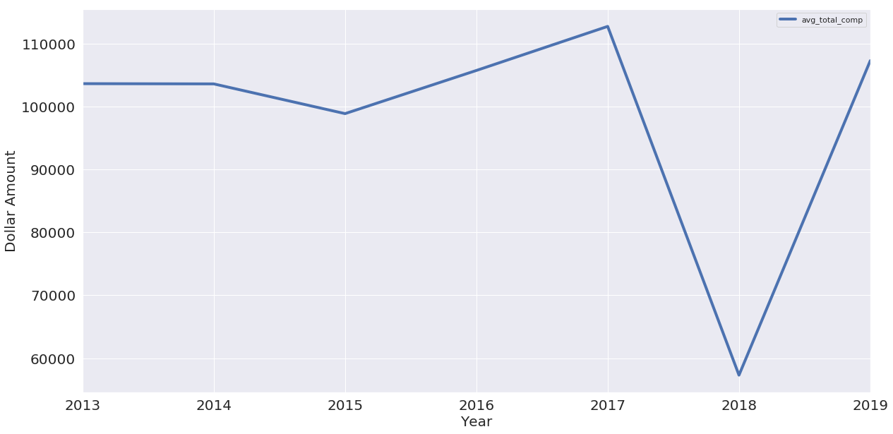
Average Total Compensation

Slide 19

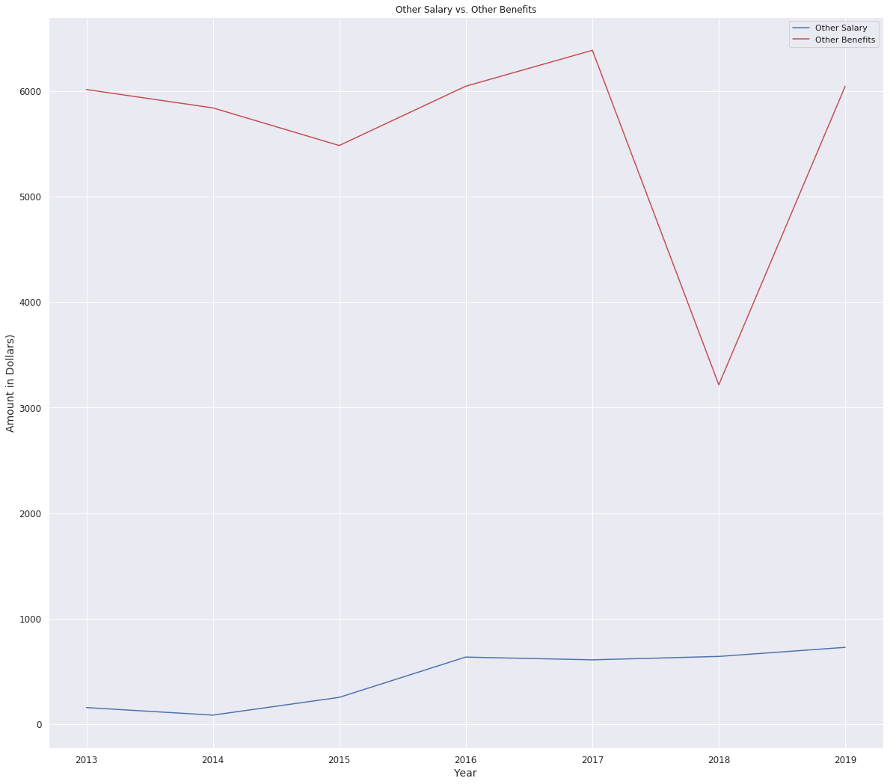
Other Salary vs. Other Benefits

Slide 20

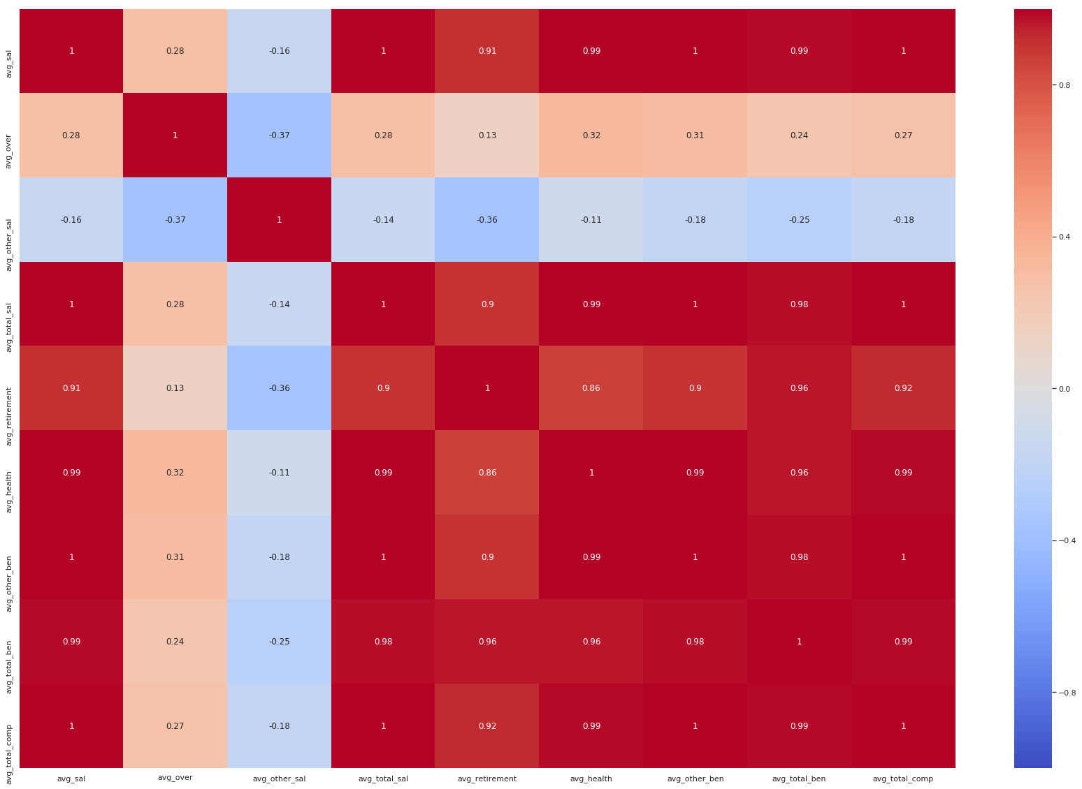
Pearson Correlation Heatmap

Slide 21
Facebook Prophet
Forecasting time series data
Used average monthly total compensation
Two dimension
Date data: (YYYY-MM-DD)
Numeric Measurement
Predict function assigns each row of data a predicted value yhat
Other dimensions included yhat_lower and yhat_upper

Slide 22
Multiplicative Model
Focus on the percentage changes, both seasonality and original data increase over time
Data = (Seasonal effect) x Trend x Cyclical x Residual
log(Data) = log(Seasonal effect x Trend x Cyclical x Residual)

Slide 23
Results
2020
Yhat: Average 3655.243
2021
Yhat: Average 3685.778
2022
Yhat: Average 3716.291
2023
Yhat: Average 3744.24
2024
Yhat: Average 3777.372
2025
Yhat: Average 3807.907
2026
Yhat: Average 3838.420
2027
Yhat: Average 3868.933
2028
Yhat: Average 3899.5
2029
Yhat: Average 3927.387

Slide 24
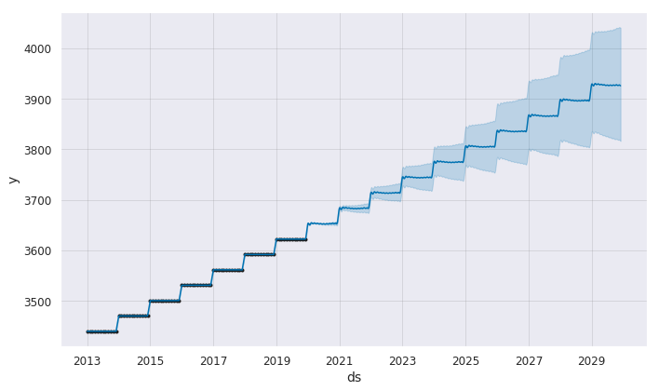
Monthly Forecast

Slide 25

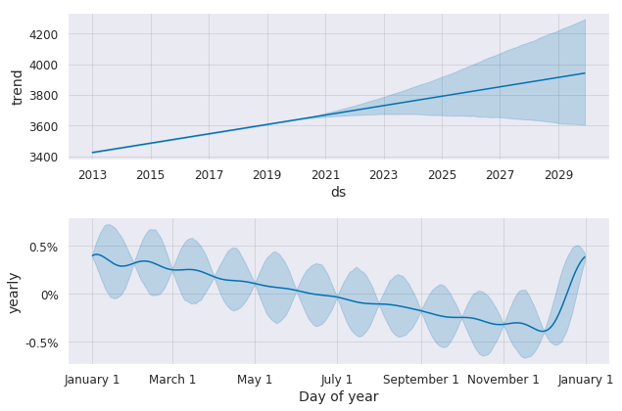
Seasonality Trend

Slide 26
Conclusion
Majority of the employee in San Francisco has compensation on the higher side with average yearly compensation as $100493.6. 50% of the employee whose salary is on the higher side has ranged from $70,025.56 to $1,35,022.8. The maximum compensation for IS Business analyst is $1,63,170 while minimum is just $664.30.
The maximum number of employees in San Francisco (more than half of the employee) is earning higher compensation i.e, more than $1,00,000.The probability that an IS Business Analyst will earn yearly compensation >= $80,000 is high as 65.13% while Probability that an IS Business Analyst will earn yearly compensation < $50,000 is low as 26.48%.
In San Francisco City, the public employee who belong to POL Police department get highest compensation among all departments.
We predicted the total salary for POL Police department for years 2018 and 2019 which shows salary is increasing over the years.
There is a fluctuation and sudden drop observed in 2018 for total compensation in San Francisco for a job IS Business Analyst.
In San Francisco, the average monthly compensation for IS Business Analyst will increase over the years. In next year, monthly compensation would be $3655.243 while after 10 years, it would be $3927.4.

Slide 27
